Slide 1
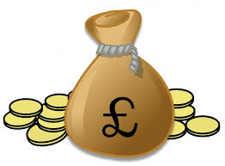
Traditional view of investment
Finance only
Impact only
Best in class/ ESG leadership:
Balance positive & negative
e.g. Unilever
Impact first:
Trade-off between financial and social returns
e.g. Thera
Traditional investment:
No focus on impact returns
Philanthropy:
No focus on financial returns
Responsible:
Focus on avoidance
e.g. Svenska Handelsbanken
Thematic:
Solve a social/ environmental challenge
e.g. Halma

Slide 2
The spectrum of investment today
Finance only
Impact only
Traditional:
No positive or negative screening
Best in class/ ESG leadership:
Balance positive & negative
Impact first:
Trade-off between financial and social returns
Responsible:
Focus on avoidance
Thematic:
Solve a social/ environmental challenge
Philanthropy:
No focus on financial returns
Rathbone Greenbank Investments
Graphic modified from Bridges Ventures’ Spectrum of Capital:
http://www.bridgesfundmanagement.com/wp-content/uploads/2017/08/Bridges-Spectrum-of-Capital-screen.pdf

Slide 3
Dimensions of impact
What
Investor intention
How much
Engagement
Who
Additionality
Impact risk

